Slide 1
Proactive Referral & Engagement Program
Fall 2018 Pilot
Dr. Samantha Nix
Academic Center for Excellence
Undergraduate Studies

Slide 2
How many semesters of college have you Taken So far?
Open Question

Slide 3
When do you know you’re struggling in a class?
Open Question

Slide 4
Why the “Proactive Referral and Engagement” Program?
“the first time I took a circuits exam […] I’m like, ‘Oooh, this isn’t that bad,’ and I get it back and it was like a 36 [out of 100].”
Participant, Dr. Nix’s dissertation (unpublished)

Slide 5
Why this program?
“the first time I took a circuits exam […] I’m like, ‘Oooh, this isn’t that bad,’ and I get it back and it was like a 36 [out of 100].”
After the drop deadline
Only 2 tests in the entire course
This student was blindsided.

Slide 6
Why this program?
We may not know what we need until we need it.
Sometimes instructors don’t know all of the resources.
It can be helpful to make one more connection on campus.

Slide 7
How does it work?
Instructor submits referral
I reach out and offer help
You get targeted assistance
Follow-up and learn

Slide 8
What are instructors telling Dr. Nix?
Class attendance
Class participation
Concerns about motivation (explain)
Disruptive/Concerning behavior (explain)
Financial concerns
Missing/late assignments
Needs assistance building...
writing skills
quantitative skills
study skills
Poor assignment/test grade
Other (explain)

Slide 9
Right of Refusal
You are not obligated to respond to the email or pick up my phone call
Even if you don’t respond initially, I would be happy to work with you if something comes up

Slide 10
What is a pilot?
You’re a part of FSU history!
Pilots = making mistakes and learning from them
4 classes, over 65 sections
MAC 1105
SLS 3140
ENC 1101
ENC 2135

Slide 11
What is a pilot?
Satisfaction survey
Focus groups
Open door policy
Give me feedback!

Slide 12
Questions so far?
Let’s pause…

Slide 13
Be PROACTIVE: Campus Resources for Academic Success

Slide 14
General Suggestions
Figure out your “why”
Time management
Write down deadlines
Plan 2 hours of study for each credit hour
Communication
Check your FSU email daily
Talk to your instructors

Slide 15
FREE Resources for YOU!
Personal Academic Consultations
(850) 645-0852
One-on-one
Topics: time management, learning styles and memory, reading strategies, general study skills, planning for graduate school & entrance exams
Topics/projects of your choice
Tutoring opportunities
ace.fsu.edu

Slide 16
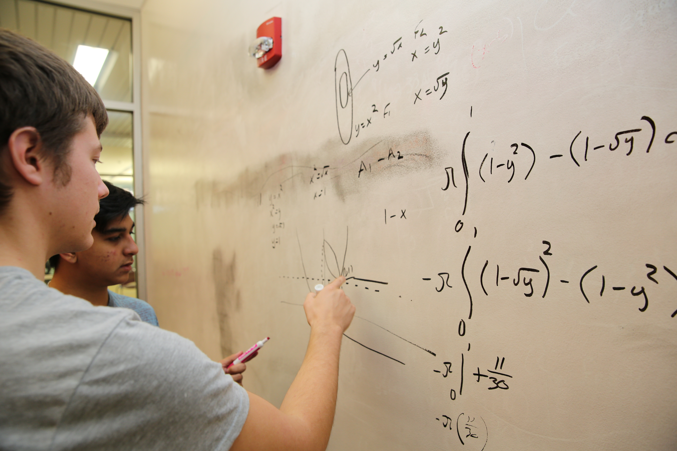
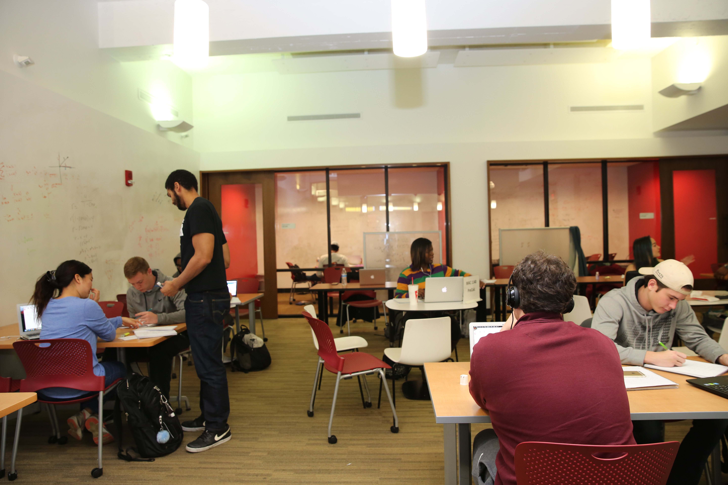
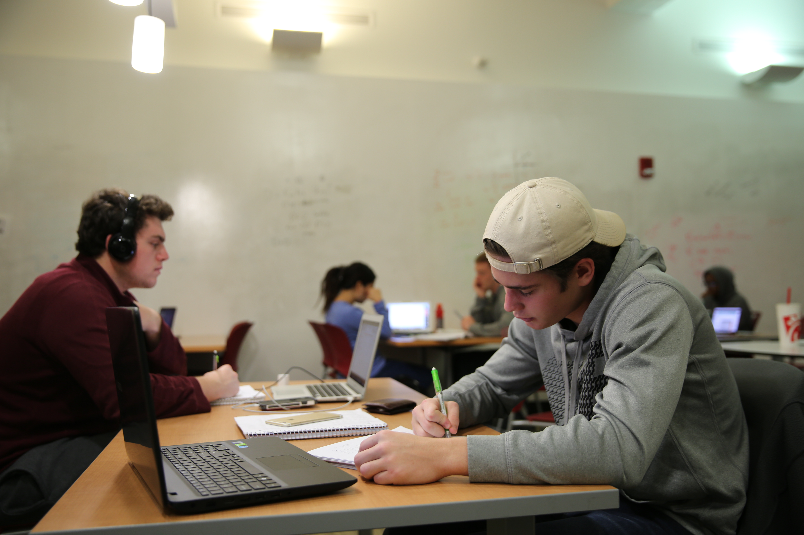
FREE Tutoring @ ACE
The Math Studio
Walk-In
Sit down and do homework
Raise hand for help
ace.fsu.edu

Slide 17
FREE Tutoring @ ACE
The Learning Studio
Over 50 courses available
By Appointment or walk-in
Tutoring starts Sept. 4th
ace.fsu.edu

Slide 18
ACE Hours & Location
Fall 2018 Hours
Mondays-Thursdays
10am-10pm
Fridays
10am-5pm
Sundays
5-10pm
ace.fsu.edu

Slide 19
FREE Tutoring @ Strozier
Math Tutoring, First Floor
Walk-In
Group tutoring
Sunday-Wednesday 9 pm-1 am
Starts Sept. 9th
https://www.lib.fsu.edu/tutoring

Slide 20
FREE ACE Workshops
Workshop | Date | Time | Location
How to Get Control of Your Time | Sept. 5 | 4-5 pm | WJB G041
Get Ready for the LSAT | Sept. 6 | 4-5 pm | WJB G041
Get Ready for the GRE | Sept. 11 | 4-5 pm | WJB G041
Making Notes (not taking them!) | Sept. 13 | 4-5 pm | WJB G041
Get Ready for the GMAT | Sept. 19 | 4-5 pm | WJB G041
Strategies for Test Preparation | Sept. 20 | 4-5 pm | WJB G041
Mindset: Learn to Learn Anything | Sept. 25 | 4-5 pm | WJB G041
Get Ready for the LSAT | Oct. 3 | 4-5 pm | WJB G041
Making the Most of Academic Help | Oct. 9 | 4-5 pm | WJB G041
Get Ready for the GRE | Oct. 10 | 4-5 pm | WJB G041
Writing a Personal Statement | Oct. 11 | 4-5 pm | WJB G041
How to Get Control of Your Time | Oct. 23 | 4-5 pm | WJB G041
How to Get the BEST Letter of Recc. | Nov. 7 | 4-5 pm | WJB G041
ace.fsu.edu

Slide 21
Other Resources
Instructor, TAs, Advisor, Life Coach, Residence Assistant/Director, Supervisor, Friend
Career Center
University Counseling Center (RENEW)
Student Disability Resource Center
Health and Wellness Center
Nole Central (student organizations)
My fave: Meditation Room (the Globe)

Slide 22
Questions? Thank you!
Samantha Nix | SNix@fsu.edu | 850-645-4047 | WJB G015

