Slide 1
Pre-Law at FSU

Slide 2
FSU Pre-Law Website
Notes:
Show the audience the prelaw.fsu.edu homepage and how to sign up for the listserv/newsletter

Slide 3
Choosing a Major
Any major is acceptable for law school
Most important factors:
High GPA
Law School Admission Test (LSAT) Scores
Connect with a Pre-Law Advisor: prelaw@fsu.edu
Talk to your academic advisors each semester stay on track!
Notes:
Encourage students to explore how their majors will provide opportunities to gain core legal skills and general soft skills necessary for any career path
May want to prompt students to consider if they have intentionally researched other career paths in addition to law school; self and career fit sometimes goes unexplored
Questions to help with declaring a major:
What topics naturally interest me?
Can I maintain a strong GPA in this major?
What skills do I want to develop?

Slide 4
Selecting Courses
No prerequisites for law school
Pursue your interests & explore
Quality > Quantity
Network with professors early!
Letters of recommendation
Notes:
Ways to network with professors:
Visiting during drop-in hours
Attending departmental social events
Asking questions during lectures
Discussing your thoughts about lecture content after class/via email
Giving ”Thank you” notes at the end of the semester

Slide 5
Academic Expectations
Start well and end well!
3.5+ GPA is most competitive
Consider course load and personal graduation timetable
# of courses per semester depends on your career plans
Ask yourself: Law school immediately or gap time/year(s)?
Notes:
Handshake is The Career Center’s database for FSU students to engage in job/internship/volunteerism searches, participate in mock interviewing, and connect with employers for informational interviews (ProfessioNole Mentors).
LinkedIn is a great resource to connect with alumni when gathering program information and career knowledge.
For Pre-Law students, this is especially helpful as they seek opportunities to develop their leadership skills and to “test the waters” of legal settings.

Slide 6
Engage in interests and passions
The Career Center
Center for Leadership & Social Change
Center for Undergraduate Research and Academic Engagement

Slide 7
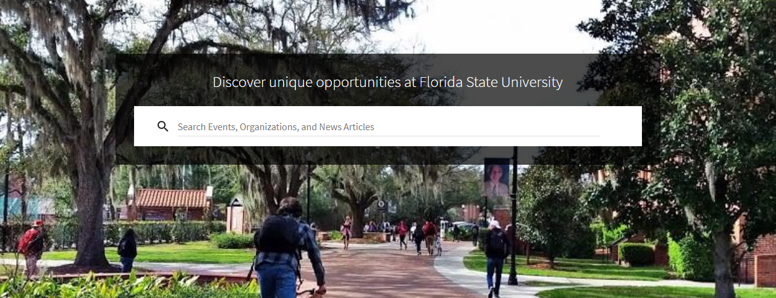
Pre-Law Societies
Black Law Student Association (BLSA)
Phi Alpha Delta – Pre-Law Fraternity International
Pre-Law Society at FSU
FSU Undergraduate Mock Trial
FSU Women in Pre-Law Society
Delta Gamma Phi Women in Pre-Law Sorority
Hundreds of student organizations to join:
Nole Central
Notes:
Being in a pre-law/legal organization does not add competiveness to one’s application anymore than another co-curricular activity would!

Slide 8
Using LSAC
Law School Admission Council (LSAC)
Necessary for applying to ABA-approved law schools
Credential Assembly Service (CAS)
Permits Law School Admission Test (LSAT) registration
Compiles application documents
CAS profile lasts for 5 years
Likelihood of Admission
Notes:
If time permits, it’s useful to show the students how the calculator works; usually the most impressive and practical tool when presenting. Ask the audience to name some schools that they would like to see statistics for.

Slide 9
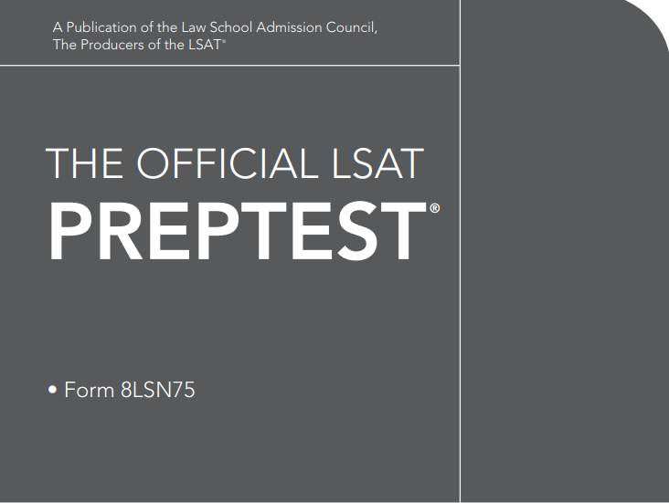
Understanding the LSAT
Scoring: 120-180; 150 is average; top-tier programs prefer 160+
Test Dates: the LSAT is not offered every month be sure to research test dates as they are released each year
Due to COVID-19 dates are subject to change
The LSAT is fully digital and taken via a tablet in a proctored testing location
GRE is gaining acceptance at various law schools
Consider the application rules for each program
Notes:
Use this opportunity to address the various methods students may use to study for the LSAT. Encourage them to take free practice tests to get a baseline score, and then use that result to inform how they need to study (e.g., lower scores may warrant $1,000+ test prep. courses).

Slide 10
Resource | Fee
Present Considerations
LSAT | $200
CAS | $195
Law School Reports | $45
Test Center Change | $125
Test Prep | Free – $1000+
Future Considerations
School Site Visits | Varies (flight, hotel, etc.)
Moving | Varies (moving property, out-of-state tuition, etc.)
Cost of Living | Varies (rent, taxes, co-curricular activities/networking events, etc.)
Notes:
Mention that LSAT resources are available on the pre-law.fsu.edu website.
Mention how Undergraduate Summer Law School programs being a helpful tool for vetting schools

Slide 11
Funding the Process
AccessLex Institute
Notes:
AccessLex Institute is a great financial literacy organization as students prepare for law school
AccessLex Analytix can also help student compare tons of variables/factors like typical scholarship offerings, bar passage rates, etc.

Slide 12
Tips for Success
Sign up for Pre-Law listserv | Meet with a Pre-Law advisor
Explore the LSAC website | Attend Pre-Law workshops and events
Take at least one practice LSAT exam | Apply to Undergraduate Law School Summer programs

Slide 13
Academic Center for Excellence (ACE)
Peer Tutoring
Study Skills Workshops
Print & Online Study Skills Resources
Academic Credit Courses
Check website for updates!

Slide 14
The Career Center
Drop-In Career Advising & Career Counseling
Career Liaison available
SDS 3340 – Introduction to Career Development
Mock Interview Program
Shadowing and Mentoring Opportunities
Visit The Career Center to Learn More

